Slide 1


WIDS PRODCO PROJECT
Team Blue
Sri Yadav
Yifei Fang
Duygu Cigman
Pooja Singh
1

Slide 2



Agenda
Introduction
Business Case
Value Proposition
Analytics Approach
Data Pipeline
Implementation
Results and Recommendations
2

Slide 3



Predictive Maintenance
Problem Definition
PRODCO installed a new integrated production line last year for more than €100million that started production 6 months ago but currently they are experiencing high defect rate. Almost 26% loss ratio in the last 3 months.
Defect detection model that classifies each product into ‘Pass’ or one of five defect types and which will enable engineering team to pinpoint the location of the issues in order to perform required maintenance and repair resulting potential Increase in Yield.
Challenge
Solution
3
Notes:
Our Challenge is: PRODCO installed a new integrated production line last year and experiencing high defective rates which is effecting the production targets, also causing massive additional costs.
Over the last 6 weeks we were investigating the issue and we have come up with some findings for a defect detection model that classifies each product into ‘Pass’ or one of five defect types and which will better enable engineering team to pinpoint the location of the issues in order to perform required maintenance and repair.
So, we are here today to advise on how to reduce defect rate and our primary goal is to use this Proof of Concept to showcase the potential uses and effectiveness of advanced analytics.

Slide 4
Business Value Proposition
Objective – Potential Increase in Yield
Objective 1
Through analysis determine the factors that lead to yield failures in the process.
Objective 2
Objective 3
Project the value gained by investigating opportunities, path or associated zones that in turn lead to cost savings.
Build a model that predicts yield failure on PRODCO’s manufacturing process.
4
Notes:
To achieve potential increase in Yield we need to know not just predicting whether the item will be a defect or not, but also in which conditions defect is likely to occur.
We have split our actual challenge into 3 different Objectives
This is the subject of this project, so let’s explore this more in the next slides.

Slide 5
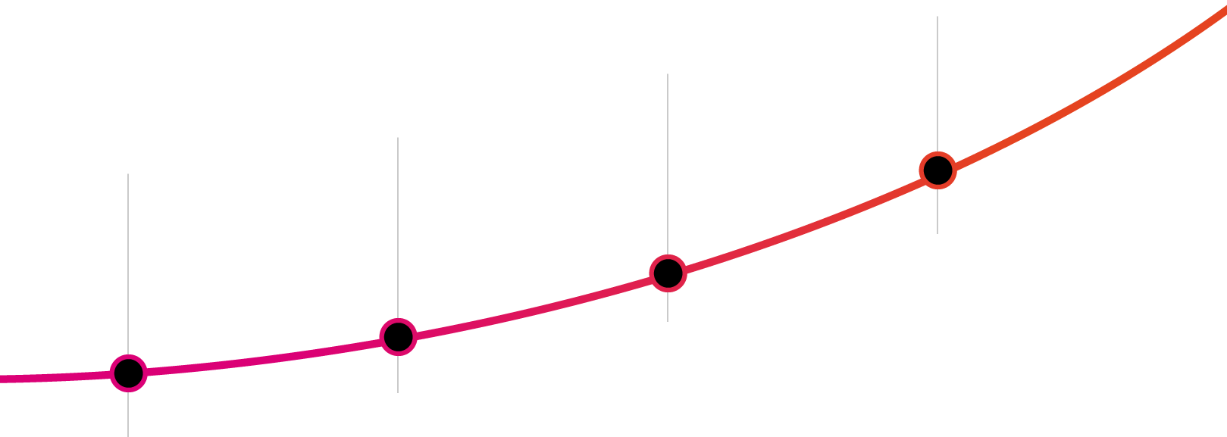
Analytics Approach
How does the service work?
EVALUATION
MILESTONE4
IMPLEMENTATION
MILESTONE3
DATA ANALYSIS
MILESTONE2
Evaluation of Models
Visualisation
Reporting the Results
BUSINESS CONSULTING
MILESTONE1
Modelling - selection of Machine Learning models
Implementation of models
Optimization
Data Understanding
Data Profiling
Statistical and Exploratory analysis
Determine Business Objectives
Formulate Assumptions
Engage with SME’s
5
Notes:
This is the brief Overview of our Analytics Approach. We followed CRISPDM methodology. In collaboration with Client SME and Business SME, we have determined business objectives.
Milestone 1: We had discovery sessions to understand the process, architecture and pain points.
The next milestone would be Statistical and Exploratory Data Analysis which is Data understanding, cleaning and profiling.
Milestone3: We built possible solutions using statistical analysis, machine learning and visualization which is implementation of models and optimising the same.
Final Milestone: We Evaluated possible solutions, synthesised client’s feedback, and reported the results.

Slide 6
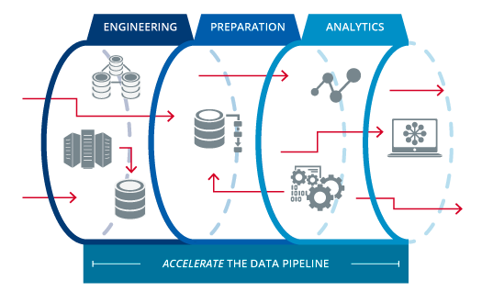
Data Pipeline
Tools mean to reach answer to questions
Sensor Data
Quality Control
Maintenance
Costs
Modelling
Source: https://medium.com/the-data-experience/building-a-data-pipeline-from-scratch-32b712cfb1db
6
Notes:
Data Engineering - Sensor Data, Quality Control, Maintenance Costs are combined, cleansed and any important features are extracted
Data preparation – joining the data, handling missing data, bridging the gaps in data, cleaning, preparation for modelling purposes
Apply multiple models and identify the best solution that helps us predict business objective which is yield failure

Slide 7
Initial Outcome from Statistical Analysis
Zone 3 area produces defective products in all SKUs and significantly affects defective product cost. It offers the opportunity to save approximately 4 million euros from the maintenance cost of defective products.
In Zone3 for C005 product defects are highly correlated with humidity. It provides the opportunity to save up to 1 Million euros on the maintenance cost of defective products for only in 326 position.
In Zone3 for A001 product defects are highly correlated with temperature when the product follow the 531 ,534 ,631 positions. Fixing issues these paths provide the opportunity to save up to 800,000 euros on the maintenance cost of defective products.
(531 position maps to Zone1 = 5th , Zone2 = 3rd , Zone3 = 1st cavities)
7
Notes:
Initial Outcome from Statistical Analysis:
There were Sensors in different zones to track environmental measures and the time taken for an item to move through the zones. So, we have identified the path that individual items take through the production line and formulated most common or general paths or patterns that items take through production line.
To perform maintenance, Engineers can use defect type combined with the data showing path, environment, and durations in and between zones for each item to try to identify the root cause of the defect.
We followed statistical analysis and identified several key points to save 4 million euros
From our Statistical analysis we found, Zone 3 area produces highest defective products in all SKUs and significantly affects defective product cost.
Within Zone3, C005 product defects are highly correlated with humidity and within same Zone3, A001 product defects are highly correlated with temperature.
We were able to spot specific zone combined positions where this was happening

Slide 8
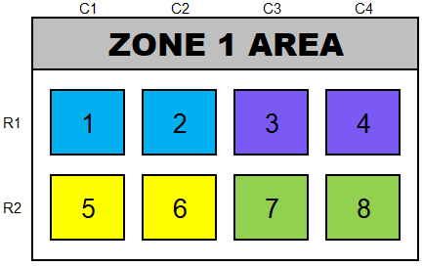
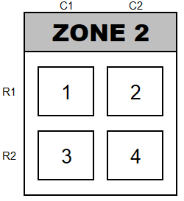
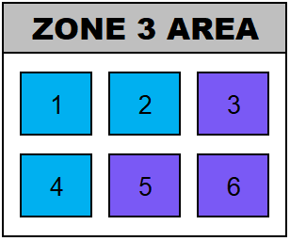
Implementation – Machine Learning
Step 1 - Determine the paths that the products take throughout the manufacturing process.
Zone 1
Zone 2
Zone 3
1
Step 2 - Modelling Random Forest Classifier because it’s a robust model that fits our problem and predicts the zone associations
8
Notes:
For example; Top Left from Zone 1 will go to specific position in Zone 2 which is Cavity 1 and then from Zone 2 it moves to Zone 3 Top Left Area. Identifying these patterns is the first step to build or determine the path. We found 6 general paths that a product takes in the manufacturing process. We built models based on different paths and were able to identify the associated zones that caused the product to be a defect.
A random forest is a meta estimator that fits a number of decision tree classifiers on various sub-samples of the dataset and uses averaging to improve the predictive accuracy and control over-fitting.
For each path we predicted the zone association factors and identified the defect count with an alternative Measure of accuracy which is F1 Score (because F1 Score is better ……) as the evaluation metric. Due to limitations of having only 3 months of data and the data is biased, our model accuracy was around 75%. If we had more information to train the model, accuracy might be improved.

Slide 9
Our Results
SKU | Zone | Identified Defects | Total Costs | Value Gained | Projected Savings
C005 | Z3 | 5733 | €5,990 | €2,293,200 | €2,287,210
A001 | Z3 | 5834 | €6,245 | €1,750,200 | €1,743,955
Z009 | Z3 | 1345 | €6,233 | €807,000 | €800,767
C005 | Z2 | 1930 | €2,250 | €772,000 | €769,750
X007 | Z3 | 718 | €6,675 | €718,000 | €711,325
B003 | Z3 | 1056 | €4,516 | €264,000 | €259,484
X007 | Z1 | 166 | €4,583 | €166,000 | €161,417
C005 | Z1 | 284 | €4,536 | €113,600 | €109,064
B003 | Z1 | 293 | €4,850 | €73,250 | €68,400
Z009 | Z2 | 97 | €3,078 | €58,200 | €55,123
Our model was accurately able to identify 83% of defects
Total projected savings are €4,031,165 for one Quarter
9
Notes:
We identified 3 opportunities where we could do cost savings
Also Although most of the defects we identified were in Zone 1 and Zone 3, we recommend to look at zone 3.
Our Top 3 opportunities relating to zone 3 will be C005, A001 and Z009 SKU’s
Our Modelling & Analysis was inline with our Statistical Analysis
If we are bringing down Z3 to fix A001 and C005 then we would also have option to fix Z009 and leaving it to engineering team to identify as we haven’t got a chance to validate the part

Slide 10

Our Recommendations
12.5%
Bring down defect rate from 26%
94% of C005 products were defective due to high humidity in Zone 3.
Z3 Maximum relative humidity
Smaller humidity range led to successful A001 products with 87% of possibility.
Z3 Humidity range
< 40%
< 7%
10
Notes:
Relative humidity under 40 percent

Slide 11



Key Highlights
Target
Metrics Breakdown
Implementation
Success Strategy
Opportunities and Cost Savings
8 – 16 € M Annual
Projected Savings
Random
Forest
Reducing Defect Rate to 12.5%
Potential Opportunity to
Costs Reduction
Quality Control
Margin Improvement
11
Notes:
We began by exploring predictive maintenance options, which shows the business opportunity and the promise of machine learning.
Using the manufacturing data, we built and deployed a predictive maintenance solution (which is combination of machine learning and statistical analysis and( could possibly save, 8-16 Million of Annual projected savings
Potential Opportunities are to reduce costs, increase margin and better customer satisfaction and save quality control costs.

Slide 12




Questions

